Slide 1
MILESTONE 3
JOB ROLE PREDICTION

Slide 2
Day 1 – Introduction to Job Role Prediction Module
What is Job Role Prediction?
Why ML is needed to map education → job roles.
Input vs Output design flow.
Overview of ML pipeline for this project.

Slide 3
📅 Day 1 — Introduction to Job Role Prediction Module
🎯 Objective of Day 1
To give students a clear understanding of:
What a Job Role Prediction model does
Why ML is used for mapping education → suitable career paths
What we will build in Milestone 3
How input will flow into the ML model and how output will look

Slide 4
Until now, you designed input forms, collected education details, and prepared preprocessing logic. Now we are moving into the main ML part – prediction.
In real-world job selection, people struggle to decide which job fits their degree or skills. Example:

Slide 5
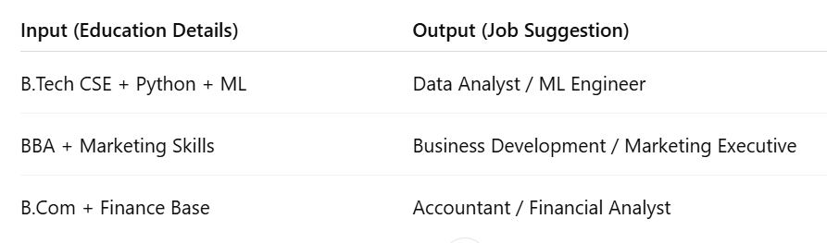

Slide 6
Our goal is to train a machine learning model that can analyze educational background and predict the most suitable job roles.

Slide 7
📍 Key Points to Explain in Class
What is Job Role Prediction?
ML model takes education details as input.
Returns 3–5 best career roles with probabilities.
Why ML is suitable?
Patterns between education and job are not straightforward.
Machine learns from data to find relationships.
Pipeline for Milestone 3:
Collect Education Input → Preprocess Data → Train ML Model
→ Predict Job Roles → Convert into Top Career Suggestions
Students should visualize the end goal clearly: At the end of Milestone 3, user will enter:
Degree, Specialization, CGPA, Certifications → Output: Top Job Roles

Slide 8
🧪 Hands-On Activity for Day 1
Students must create the project structure to prepare coding in upcoming sessions.
📁 Project Folder Structure
Milestone3_JobPrediction
│── dataset/ # dataset for training model
│── model/ # trained model will be saved later
│── preprocessing/ # encoding & cleaning scripts
│── training/ # ML model training notebook/py file
│── backend/ # API development later
│── frontend/ # UI for showing output later
└── README.md

Slide 9
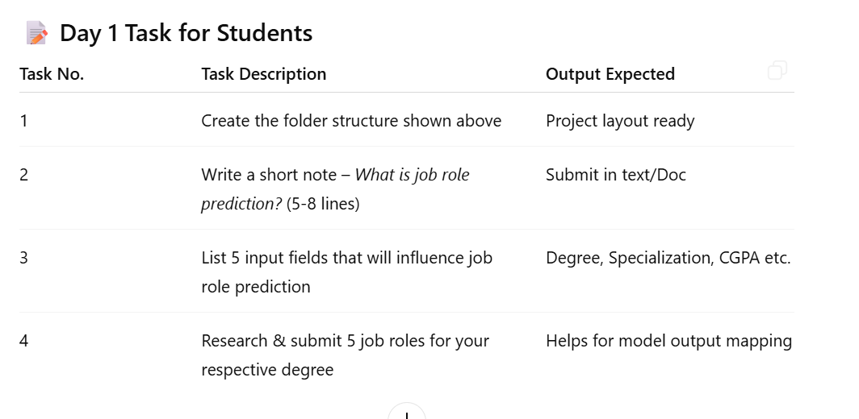

Slide 10
Submission Format
📄 Google Doc / Word file 📁 Screenshot of created project folder

Slide 11
By end of DAY 1, students must understand:
✓ What this milestone is about ✓ What will be predicted ✓ How input → output workflow happens ✓ Folder structure ready + task submitted

Slide 12
Day 2 – Understanding Dataset
Columns & meaning: degree, specialization, CGPA, certifications, etc.
Target variable = job role.
Identify categorical & numerical fields.
Basic Exploratory Data Analysis.

Slide 13
On Day 2, students focus on exploring the dataset used for Job Role Prediction. Before building any ML model, you must understand what data you have, what it means, and how to analyze it.

Slide 14
1️⃣ What is a Dataset? (Simple Explanation)
A dataset is a collection of rows and columns — like an Excel sheet.
Each row = 1 student's profile
Each column = a feature (degree, specialization, CGPA, certifications, etc.)
Target column = job role (The output we want the model to predict)
This understanding is the foundation for model building.

Slide 15
2️⃣ Columns in the Dataset & Their Meaning
Below are the common columns in an education-based job prediction dataset:

Slide 16
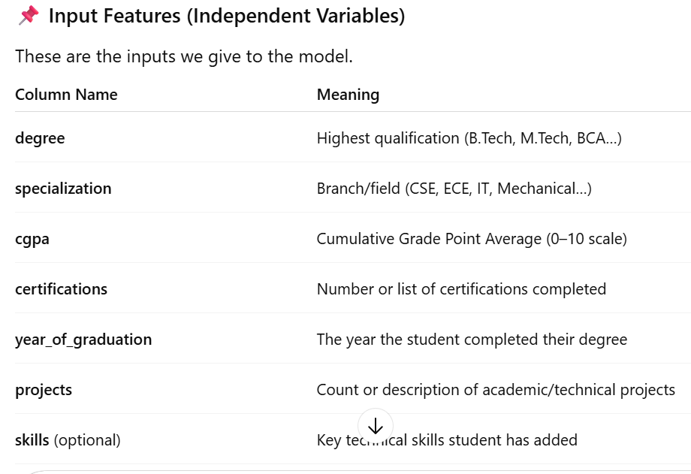

Slide 17
🎯 Target Variable (Output We Predict)
job_role Examples:
Software Developer
Data Analyst
Cloud Engineer
Frontend Developer
Machine Learning Engineer
This is the value the ML model will try to predict.

Slide 18
3️⃣ Identifying Numerical vs. Categorical Columns
Before preprocessing, you must classify the data into two types:
✔ Numerical Columns
Contain numbers that can be used for calculations:
CGPA
Year of Graduation
Project Count
Number of Certifications
These columns are used “as numbers” in the ML model.

Slide 19
✔ Categorical Columns
Contain text categories. ML models cannot understand raw text, so these are later encoded.
Examples:
Degree (B.Tech, M.Tech, B.Sc)
Specialization (CSE, ECE, Mechanical)
Certifications Type (AWS, Python…)
Job Role (Target)
Categorical data needs Label Encoding or One-Hot Encoding in later stages.

Slide 20
4️⃣ Basic EDA (Exploratory Data Analysis)
EDA helps you understand the dataset before training the model. Below are the beginner-friendly EDA steps:
🔍 Step 1: Check Shape of the Dataset
How many rows?
How many columns?
Example:
1200 rows × 8 columns

Slide 21
🔍 Step 2: View First 5 Rows (Head of Dataset)
This gives an idea of how the data looks.
🔍 Step 3: Check Data Types
Helps identify which columns are:
numerical
categorical
object/string
boolean

Slide 22
🔍 Step 4: Check Missing Values
Find out if any student’s profile has empty fields.
Example:
CGPA missing?
Specialization empty?
These must be handled during preprocessing.
🔍 Step 5: Value Counts for Important Columns
Examples:
How many students are from CSE?
How many have Software Developer as a job role?
This helps identify:
class imbalance
common degrees
popular specializations

Slide 23
🔍 Step 6: Summary Statistics (Describe)
For numerical columns:
mean
min
max
standard deviation
Example Checks:
Average CGPA
Highest/lowest CGPA
Are there unrealistic values (CGPA >10)?
🔍 Step 7: Identify Outliers
Unusual values that might affect model performance.
Example:
CGPA = 2 (Too low?)
Certifications = 50 (Unrealistic?)

Slide 24
5️⃣ Why Day 2 is Important in Milestone 3
Understanding the dataset helps you:
Clean the data properly
Choose correct preprocessing steps
Know what features actually affect job role prediction
Prepare for model training on Day 3–Day 4
This is the foundation for the machine learning pipeline.

Slide 25
🎯 Day 2 Output (What Student Should Achieve)
By the end of Day 2, student should be able to:
✔ Understand every column in the dataset ✔ Identify input features and target variable ✔ Classify numerical vs categorical variables ✔ Perform basic EDA ✔ Detect missing values & outliers ✔ Prepare a summary report of dataset insights

Slide 26
✔ Output Submission for Day 2
Students must submit a PDF or screenshot containing:
Column list
Numerical vs categorical separation
Identified target variable
Basic EDA results
Summary of findings

Slide 27
Day 3 – Data Preprocessing
Label Encoding & One-Hot Encoding.
Handling missing values.
Feature scaling / normalization.
Convert clean data into model-ready format.

Slide 28
🎯 Goal of Day 3
Today is about cleaning, converting, and preparing the dataset so that the machine learning model can understand it.
Raw data cannot be directly used for training. We must encode, clean, scale, and properly format the dataset.

Slide 29
1️⃣ What is Data Preprocessing?
Data preprocessing means transforming raw data into clean, structured, and numerical format so ML models can read it.
It includes:
Fixing missing values
Converting text to numbers (encoding)
Scaling numerical values
Creating a final "model-ready" dataset

Slide 30
2️⃣ Label Encoding & One-Hot Encoding
🔠 Why Encoding is Needed?
ML models cannot understand text. They only understand numbers.
So we convert categorical columns (degree, specialization, job_role) into numeric format.

Slide 31
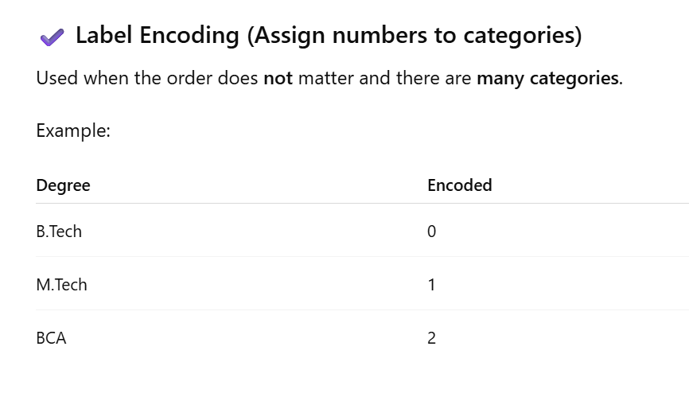

Slide 32
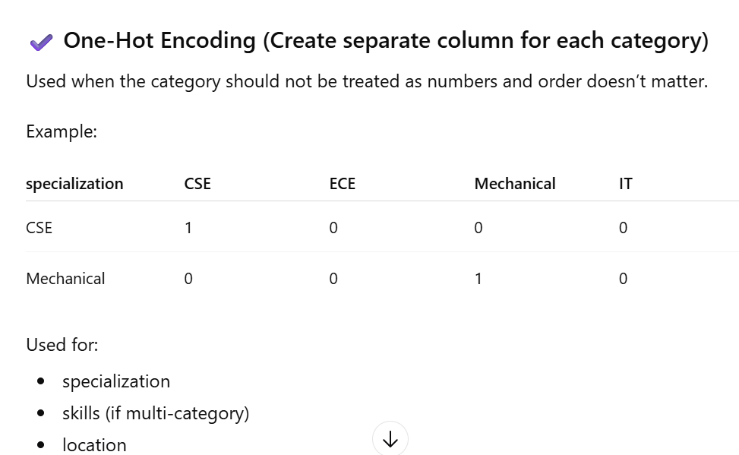

Slide 33
3️⃣ Handling Missing Values
Missing values create errors during training. We must replace or remove them.
Common Techniques:
✔ Numerical Columns
Use mean or median Example: Missing CGPA → replace with average CGPA
✔ Categorical Columns
Use mode (most frequent value) Example: Missing specialization → fill with CSE if it is the most common
✔ When to drop rows?
Drop only when:
Too many missing fields
Data is unusable

Slide 34
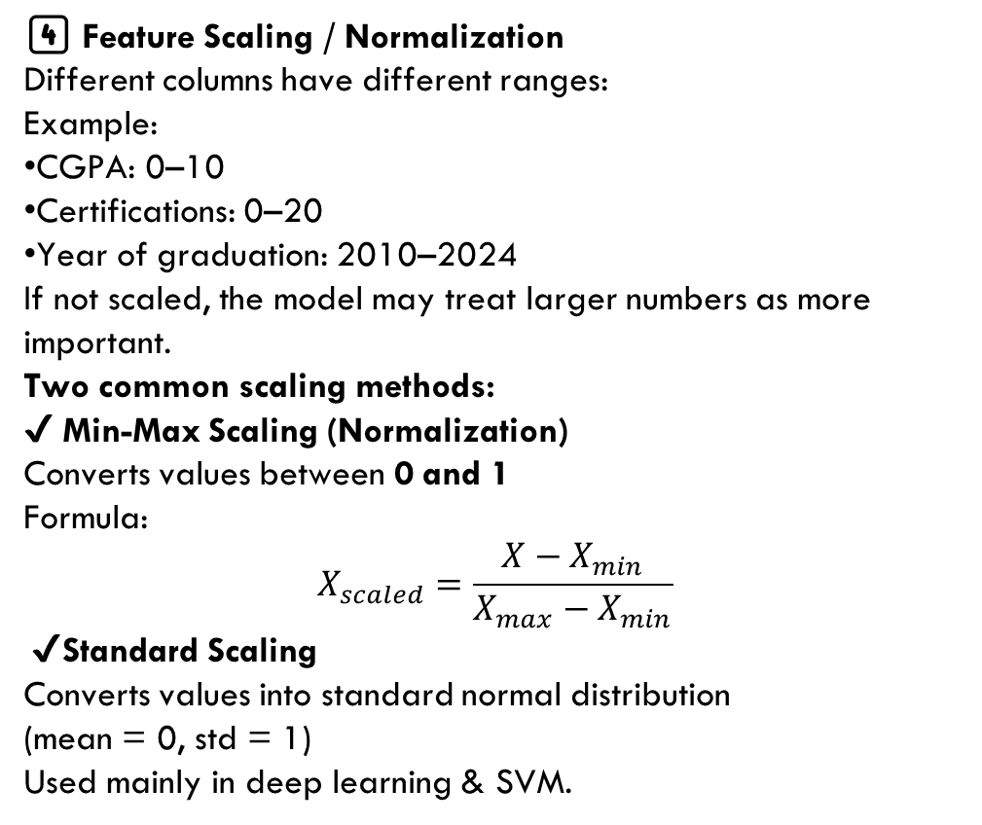
4️⃣ Feature Scaling / Normalization
Different columns have different ranges:
Example:
CGPA: 0–10
Certifications: 0–20
Year of graduation: 2010–2024
If not scaled, the model may treat larger numbers as more important.
Two common scaling methods:
✔ Min-Max Scaling (Normalization)
Converts values between 0 and 1
Formula:
$$X_{scaled}=\frac{X−X_{min}}{X_{max}−X_{min}}$$
✔ Standard Scaling
Converts values into standard normal distribution (mean = 0, std = 1)
Used mainly in deep learning & SVM.

Slide 35
5️⃣ Convert Clean Data Into Model-Ready Format
After preprocessing, your dataset should be:
✔ Fully numeric
✔ No missing values
✔ Encoded categorical columns
✔ Scaled numerical values
✔ Separated into:
X (features/input)
y (target/job_role)

Slide 36
Example:
X = [degree_encoded, specialization_onehot, cgpa_scaled, certifications, projects]
y = job_role_encoded
This final X and y will be used for Day 4: Model Training.

Slide 37
📝 Day 3 — TASKS FOR STUDENTS
Task 1: Perform Label Encoding
Task 2: Apply One-Hot Encoding
Task 3: Handle Missing Values
Task 4: Apply Feature Scaling
Select either:
Min-Max Scaling or
Standard Scaling
t ask 5: Create Final Model-Ready Dataset
Submit:
✔ Final X dataset (features only) ✔ Final y dataset (target only) ✔ Confirmation that dataset has:

Slide 38
✔ Output Submission for Day 3
Students must submit a PDF/screenshot containing:
Encoded columns screenshots
Missing value handling summary
Scaled feature table
Final X and y dataset representation

Slide 39
Day 4 – Train-Test Split
Why split data?
Train/Test/Validation sets.
Avoiding data leakage.
Create X (features) & y (labels).

Slide 40
🎯 Goal of Day 4
Today students learn how to split the dataset so the machine learning model can be trained correctly and evaluated fairly.
This step prevents overfitting and ensures the model can generalize to new students’ profiles.

Slide 41
1️⃣ Why Split the Data?
You cannot train a model on the entire dataset and then test it on the same data. That would give unrealistic accuracy because the model already saw the answers.
Splitting solves this.
✔ Train Set
Used to teach the model patterns. (Usually 70–80% of data)
✔ Test Set
Used to evaluate the model. (Usually 20–30% of data)
✔ Validation Set (Optional for small projects)
Used to tune hyperparameters. Often taken from the training set.

Slide 42
2️⃣ Train/Test/Validation Explained (Simple & Clear)
▶ Train Set
Model learns:
relationships
patterns
correlations
Example:
High CGPA → Data Analyst
CSE → Software Developer

Slide 43
▶ Validation Set
Used during training to improve the model:
choose best hyperparameters
prevent overfitting
adjust model complexity
Example:
Deciding number of trees in Random Forest
If not using separate validation:
we use train_test_split + cross-validation.

Slide 44
▶ Test Set
Model never sees this during training. Used only at the end to check accuracy.
Example:
Realistically test on "new student" profiles
Evaluate prediction quality

Slide 45
3️⃣ Avoiding Data Leakage (Very Important)
❌ What is Data Leakage?
When information from the test set accidentally gets into the training process.
This makes accuracy artificially high and completely unrealistic.
Examples of Data Leakage
Scaling entire dataset before splitting
Encoding entire dataset before splitting
Using test data for hyperparameter tuning
Manually checking test data and adjusting model
✔ How to Prevent Leakage
First do train_test_split
Then perform:
encoding
scaling
imputation inside the training data only
This ensures fair evaluation.

Slide 46
4️⃣ Create X (Features) and y (Labels)
Before splitting, divide the dataset into:
X → all feature columns
y → target column (job_role encoded)
Example:
X contains:
degree (encoded)
specialization (one-hot)
cgpa (scaled)
certifications
projects
y contains:
job_role (label encoded)
This is the fundamental input and output structure for ML models.

Slide 47
5️⃣ Perform Train–Test Split
Common ratios:
80% train – 20% test
70% train – 30% test
Standard split example:
X_train, X_test, y_train, y_test = train_test_split(
X, y, test_size=0.2, random_state=42)

Slide 48
📝 Day 4 — TASKS FOR STUDENTS
Task 1: Create X and y
Task 2: Perform Train–Test Split
Task 3: Explain Train/Test/Validation in your own words
Task 4: Identify Risks of Data Leakage
Task 5: Ensure No Leakage Happened

Slide 49
Day 5 – Model Selection Fundamentals
Introduction to ML models for classification:
Random Forest
XGBoost
Logistic Regression
Why ensemble models are better for multi-class prediction.

Slide 50
🎯 Goal of Day 5
Students learn:
What ML models can be used for multi-class job role prediction
How each model works
Why ensemble models (Random Forest, XGBoost) perform better
How to choose the best model for your dataset
Today is fully theory + understanding.

Slide 51
1️⃣ What is Classification? (Beginner-friendly)
Since job_role has multiple categories (Developer, Analyst, Cloud, ML Engineer…), this is a multi-class classification problem.
A classification model learns from:
CGPA
Degree
Specialization
Projects
Certifications
and predicts which job role fits best.

Slide 52
2️⃣ Introduction to ML Models for Classification
Below are the 3 most important models you teach for Milestone 3.
✔ Model 1: Logistic Regression (Baseline Classifier)
What it is:
A simple machine learning algorithm used for:
binary classification (2 outputs)
multi-class classification (using Softmax)
How it works:
It draws boundaries between classes using a linear equation.
Advantages:
Fast
Lightweight
Good baseline model
Easy to explain
Disadvantages:
Works poorly with:
non-linear data
complex patterns
high category features
Not the best for job prediction, but good as a starting point.

Slide 53
Day 6 – Model Training
Train Random Forest / XGBoost model.
Fit data & generate classification output.
Evaluate using accuracy, F1-score.

Slide 54
🎯 Objective
Train a Machine Learning model that can predict suitable job roles based on a user’s education details and evaluate its performance using proper metrics.

Slide 55
1️⃣ Why Model Training is Needed
After preprocessing (encoding, scaling, cleaning), we now have numerical data that a machine learning model can understand.
Model training helps the system:
Learn patterns between education details (degree, specialization, CGPA, skills)
And the job role associated with similar profiles
So it can predict job roles for new users accurately

Slide 56
2️⃣ Models Used in Milestone 3
🔹 Random Forest Classifier
An ensemble model (uses multiple decision trees)
Each tree votes for a job role
Final prediction is the most common vote
Works well for multi-class problems like job role prediction
🔹 XGBoost (Optional / Advanced)
Gradient boosting algorithm
Learns from mistakes of previous trees
Faster and often more accurate than Random Forest
Suitable when dataset is large and complex
👉 In Milestone 3, at least one model (Random Forest) must be trained successfully.

Slide 57
3️⃣ Training the Model (Fit the Data)
Step 1: Prepare Training Data
X (Features)
Degree (encoded)
Specialization (encoded)
CGPA (scaled)
Certifications / Skills (encoded)
y (Target / Label)
Job Role (e.g., Software Engineer, Data Analyst, ML Engineer)

Slide 58
Step 2: Train the Model
The model is given X_train and y_train
It learns relationships between education details and job roles
This process is called fitting the model
📌 Example concept (not code):
“The model learns that students with B.Tech + CS + high CGPA often become Software Engineers.”

Slide 59
4️⃣ Generate Classification Output (Predictions)
After training:
The model is tested on X_test
It predicts job roles for unseen data
Output is:
Predicted Job Role
Probability / Confidence score (optional)
📌 Example:
Input Profile → B.Tech, AI, CGPA 8.4
Predicted Role → Data Scientist

Slide 60
5️⃣ Model Evaluation Metrics
Evaluation tells us how good the model is.
✅ Accuracy
Measures how many predictions were correct overall
Simple and easy to understand
📌 Formula:
Accuracy = Correct Predictions / Total Predictions
📌 Example:
80 correct predictions out of 100 → Accuracy = 80%

Slide 61
✅ F1-Score (Very Important for Milestone 3)
Balances Precision and Recall
Useful when:
Multiple job roles exist
Some roles have fewer samples
📌 Why F1-score?
Accuracy alone can be misleading
F1-score shows how well each job role is predicted
📌 Example:
Model predicts “Data Analyst” correctly without confusion
High F1-score means reliable predictions

Slide 62
✅ Task 1: Load Preprocessed Dataset
✅ Task 2: Split Data into Features & Target
✅ Task 3: Train Random Forest Model
✅ Task 4: Generate Predictions
Use trained model to predict job roles for test data
Store predicted job roles
📌 Output:
Predicted job roles list
✅ Task 5: Evaluate Model Performance
Evaluate the model using:
🔹 Accuracy Score
Check overall correctness of predictions
🔹 F1-Score
Measure balance between precision and recall
Use weighted or macro F1-score for multi-class job roles

Slide 63
6️⃣ Outcome of Day 6
By the end of Day 6:
✔ Model (Random Forest / XGBoost) is trained ✔ Job role predictions are generated ✔ Model performance is evaluated ✔ Best model is selected for backend integration

Slide 64
Day 7 – Top Job Role Recommendation
Predict top 3-5 roles instead of single output.
Return probability-based ranking.
Show confidence score for each recommendation.

Slide 65
📅 Day 7 – Top Job Role Recommendation
📝 Task (Milestone 3)
🎯 Objective
Enhance the trained ML model to recommend Top 3–5 suitable job roles instead of a single prediction, using probability-based ranking and confidence scores.

Slide 66
1️⃣ Why Top Job Role Recommendation?
In real-world career guidance:
A student can fit multiple job roles
A single prediction may be too rigid
Ranking roles gives better career flexibility
👉 This improves user experience and evaluation score in Milestone 3.

Slide 67
2️⃣ Task 1: Use Probability Prediction
Use trained model’s predict_proba() method
This returns probability scores for all job roles
Each probability represents how well the profile matches that role
📌 Example:
Data Scientist → 0.42
ML Engineer → 0.28
Data Analyst → 0.18

Slide 68
3️⃣ Task 2: Rank Job Roles by Probability
Sort predicted job roles in descending order
Select Top 3 to Top 5 roles
Ignore low-probability roles
📌 Output:
1. Data Scientist
2. ML Engineer
3. Data Analyst

Slide 69
4️⃣ Task 3: Calculate Confidence Score
Convert probability values into percentage
Confidence Score = Probability × 100
📌 Example:
Data Scientist → 42%
ML Engineer → 28%
Data Analyst → 18%

Slide 70
5️⃣ Task 4: Return Recommendation Response
Return job role list along with confidence scores
Structure output for frontend display
📌 Sample Response Format:
[
{ role: "Data Scientist", confidence: "42%" },
{ role: "ML Engineer", confidence: "28%" },
{ role: "Data Analyst", confidence: "18%" }
]

Slide 71
6️⃣ Task 5: Save Prediction History
Store:
User ID
Input education details
Recommended job roles
Confidence scores
Timestamp
📌 Used for:
User history
Admin analysis
Milestone evaluation proof

Slide 72
📊 Expected Deliverables (Day 7)
✔ Top 3–5 job roles generated ✔ Probability-based ranking implemented ✔ Confidence score shown for each role ✔ Prediction history saved

Slide 73
Day 8 – Backend Integration
Build API to send input → get prediction.
Endpoint: /predict-job-role
Return JSON response with roles + probabilities.

Slide 74
🎯 Objective
Integrate the trained ML model with the backend by creating an API that:
Accepts user education details as input
Sends data to the ML model
Returns Top 3–5 job role recommendations with probabilities in JSON format

Slide 75
1️⃣ API Overview
🔗 Endpoint
POST /predict-job-role
🔐 Access
Authenticated users (JWT protected – optional for demo)

Slide 76
2️⃣ 1: Design API Request Structure
📥 Request Body (JSON)
User sends education details from frontend form.
{
"degree": "B.Tech",
"specialization": "Computer Science",
"cgpa": 8.4,
"certifications": ["Python", "Machine Learning"]
}
📌 Input must follow same format & encoding used during training.

Slide 77
3️⃣ 2: Backend Processing Flow
When API is called:
Receive input from frontend
Validate input fields
Apply:
Label encoding
One-hot encoding
Feature scaling
Convert input into model-ready format
Pass data to trained ML model
Generate probability-based predictions

Slide 78
4️⃣ 3: Call ML Model & Get Predictions
Use predict_proba() method
Extract probabilities for all job roles
Sort results in descending order
Select Top 3–5 job roles
📌 Internal logic:
Model → Probabilities → Ranking → Top roles

Slide 79
5️⃣ 4: Create JSON Response
📤 Response Format (JSON)
{
"status": "success",
"recommendations": [
{
"job_role": "Data Scientist",
"confidence": 42.5
},
{
"job_role": "ML Engineer",
"confidence": 28.3
},
{
"job_role": "Data Analyst",
"confidence": 17.9
}
]
}
📌 Confidence = Probability × 100

Slide 80
6️⃣ 5: Save Prediction History (Optional but Recommended)
Store in database:
User ID
Input education details
Predicted job roles
Confidence scores
Timestamp
📌 Used for:
User history dashboard
Admin analytics
Milestone proof

Slide 81
📊 Expected Deliverables (Day 8)
✔ Working backend API /predict-job-role ✔ JSON response with top job roles ✔ Probability-based confidence scores ✔ Integrated ML model

Slide 82
Day 9 – UI / Result Visualization
Frontend connects to prediction API.
Display output like:
Recommended Job Role
Alternative Careers
Confidence Score
Save history to profile.

Slide 83
🎯 Objective
Connect the frontend with the prediction API and visually display the job role recommendations in a user-friendly way.
On this day, students learn how:
Frontend sends user education details to backend API
Backend returns predicted job roles with confidence scores
UI displays results clearly for users
Prediction history is saved in user profile

Slide 84
🔹 Frontend–Backend Flow
User fills education details form
Frontend calls /predict-job-role API
Backend returns JSON response
UI displays prediction results
Results are saved to user history

Slide 85
🔹 What to Display on UI
The output screen should show:
✅ Recommended Job Role
Top predicted job role (highest confidence)
✅ Alternative Careers
2–4 additional suitable job roles
Shown as secondary options
✅ Confidence Score
Percentage value for each role
Helps user understand prediction strength
📌 Example:
Data Scientist – 42%
ML Engineer – 28%
Data Analyst – 18%

Slide 86
✅ Task 1: Connect Frontend to Prediction API
Use fetch / axios to call:
POST /predict-job-role
Send education details as request body
Handle success and error responses
✅ Task 2: Display Prediction Results on UI
Create a result section that shows:
🔹 Top Recommended Job Role
🔹 Alternative Careers list
🔹 Confidence score for each role
📌 Use:
Cards
Progress bars
Percentage text

Slide 87
✅ Task 3: Save Prediction History
Store prediction result in user profile
Include:
Input details
Recommended roles
Confidence scores
Date & time
✅ Task 4: UI Enhancements (Optional)
Loading indicator while prediction is processing
Error message if API fails
Clean layout with headings and icons

Slide 88
📊 Expected Deliverables (Day 9)
✔ Frontend successfully calls backend API ✔ Prediction results displayed clearly ✔ Confidence scores visible ✔ Prediction history saved to profile

Slide 89
Day 10 – Final Model Review + Evaluation
Testing with different student profiles.
Improving accuracy with hyperparameter tuning.
Final milestone demonstration + documentation.

Slide 90
🎯 Objective
Day 10 focuses on validating the complete system, improving model performance, and preparing for final Milestone 3 demonstration and evaluation.
By this stage:
ML model is trained
Backend API is integrated
Frontend displays predictions
Now we ensure the system works accurately, reliably, and end-to-end.

Slide 91
🔹 What Happens on Day 10?
1️⃣ Testing with Different Student Profiles
Test the system using:
Different degrees
Different specializations
Low, average, and high CGPA
Varying skill combinations
Verify:
Predictions are logical
Top job role changes with input
Confidence scores are reasonable
📌 Example test cases:
B.Tech CSE, CGPA 9.0 → Software/Data roles
B.Sc, Statistics, CGPA 7.5 → Analyst roles
MBA, Marketing → Business roles

Slide 92
2️⃣ Improving Accuracy using Hyperparameter Tuning
Adjust model parameters to improve performance
🔹 Random Forest Tuning Examples:
Number of trees
Tree depth
Minimum samples split
🔹 XGBoost (if used):
Learning rate
Number of estimators
Max depth
📌 Goal:
Increase Accuracy
Improve F1-score
Reduce wrong predictions

Slide 93
3️⃣ Final Model Selection
Compare:
Base model vs tuned model
Choose the best-performing model
Save final model for production use
4️⃣ Final Milestone Demonstration
During demo:
Show UI input form
Enter sample student profile
Display:
Recommended job roles
Alternative careers
Confidence scores
Show prediction history saved

Slide 94
5️⃣ Documentation Preparation
Document:
Dataset description
Preprocessing steps
Model used
Evaluation metrics
Screenshots of UI & results
📌 This acts as proof of work for Milestone 3.

Slide 95
📝 Day 10 – Task
✅ Task 1: Test Multiple Student Profiles
Create 5–10 test cases
Validate prediction output
Note any incorrect predictions
✅ Task 2: Apply Hyperparameter Tuning
Tune Random Forest / XGBoost
Re-evaluate accuracy & F1-score
Select best parameters
✅ Task 3: Final Model Evaluation
Record:
Accuracy
F1-score
Use confusion matrix (optional)
✅ Task 4: Final Demo Preparation
Prepare live demo flow
Keep sample inputs ready
Explain model decisions clearly

Slide 96
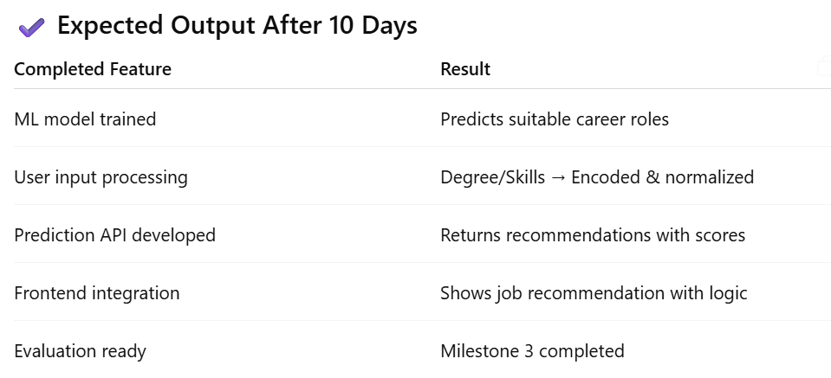

Slide 97
Milestone 3: Weeks 6–7 Module 3: Job Role Prediction
• Integrate trained ML model (e.g., Random Forest, XGBoost).
• Backend API to return predictions with confidence scores.
• Display top job suggestions with explanation/justification.
• Save result to user history.

Slide 98
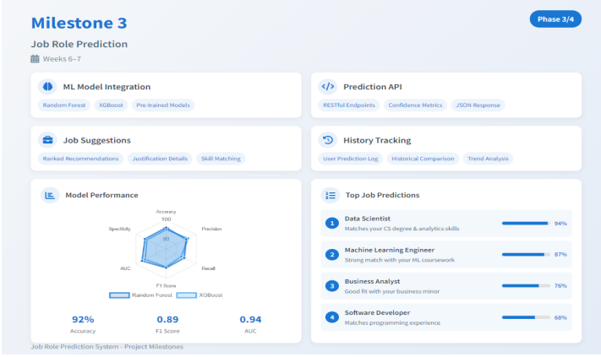

Slide 99
Milestone 3 Evaluation (Week 7):
• Model predictions are integrated and working with real input data.
• Output shows top roles with confidence and justification.
• Prediction history is saved and accessible.

